Slide 1
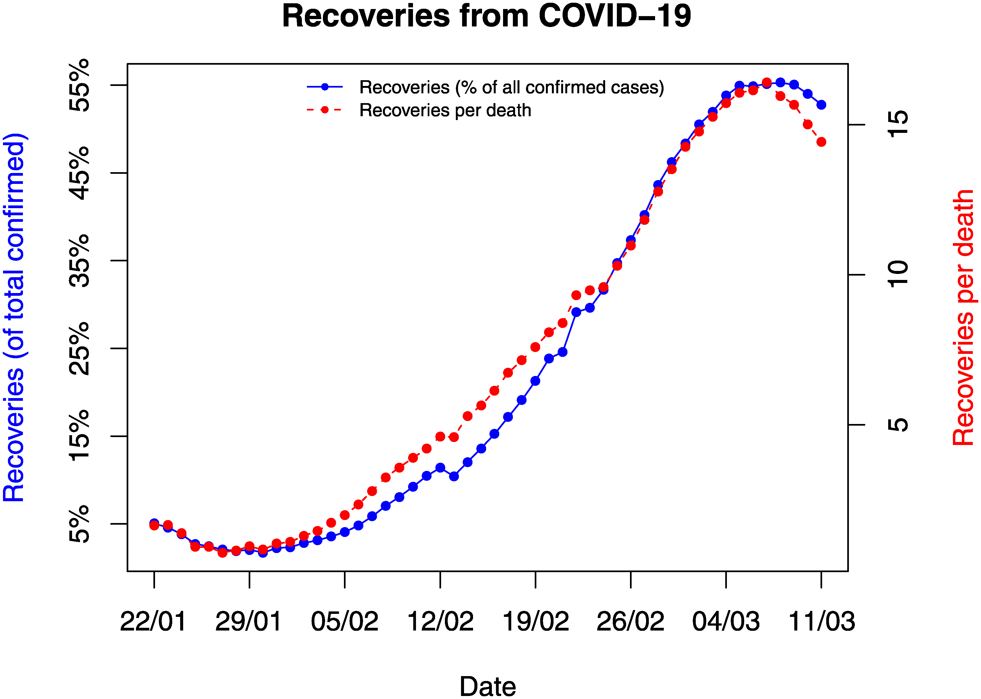
COVID-19 Future Forecasting Using Supervised Machine Learning Models
Rohan Ajmera
A1 1911002

Slide 2
INTRODUCTION
Machine learning (ML) has proved itself as a prominent field of study over the last decade by solving many very complex and sophisticated real-world problems.
In particular, the study is focused on live forecasting of COVID-19 confirmed cases and study is also focused on the forecast of COVID-19 outbreak and early response.
These prediction systems can be very helpful in decision making to handle the present scenario to guide early interventions to manage these diseases very effectively.
To contribute to the current human crisis our attempt in this study is to develop a forecasting system for COVID-19.

Slide 3
INTRODUCTION - CONTINUED
The forecasting is done for the three important variables of the disease for the coming 10 days: 1) the number 0f New confirmed cases. 2) the number of death cases 3) the number of recoveries.
This problem of forecasting has been considered as a regression problem in this study, so the study is based on some state-of-art supervised ML regression models.
The learning models have been trained using the COVID-19 patient stats dataset provided by Johns Hopkins. The dataset has been preprocessed and divided into two subsets: training set (85% records) and testing set (15% records).
The performance evaluation has been done in terms of important measures including R-squared score, Adjusted R-squared Score , mean square error, mean absolute error (MAE), and root mean square error.

Slide 4
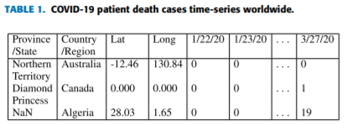
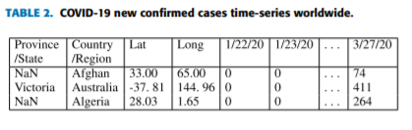
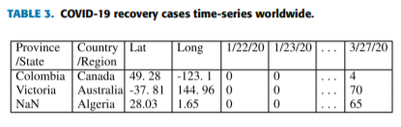
I. MATERIALS AND METHOD DATASETS
The dataset used in the study has been obtained from the GitHub repository provided by the Center for Systems Science and Engineering, Johns Hopkins University.

Slide 5
II. SUPERVISED MACHINE LEARNING MODELS
Four regression models have been used in this study of COVID-19 future forecasting:
Linear Regression
LASSO Regression
Support Vector Machine
Exponential Smoothing
The next slides show how each model works to get desired results.

Slide 6
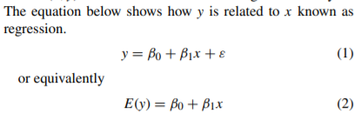
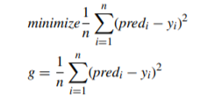
LINEAR REGRESSION
Linear regression a type of regression modeling is the most usable statistical technique for predictive analysis in machine learning. Each observation in linear regression depends on two values, one is the dependent variable and the second is the independent variable. Linear regression determines a linear relationship between these dependent and independent variables
To put the concept of linear regression in the machine learning context, in order to train the model x is represented as input training dataset, y represents the class labels present in the input dataset. The goal of the machine learning algorithm then is to find the best values for β0 (intercept) and β1(coefficient) to get the best-fit regression line. To get the best fit implies the difference between the actual values and predicted values should be minimum, so this minimization problem can be represented as:

Slide 7

LASSO REGRESSION
LASSO is a regression model belongs to the linear regression technique which uses shrinkage. Shrinkage in this context refers to the shrinking of extreme values of a data sample towards central values. The shrinkage process thus makes LASSO better and more stable and also reduces the error. LASSO is considered as a more suitable model for multicollinearity scenarios.
The models are made sparse with few coefficients in this case of regularization since the process eliminates the coefficients when their values are equal to zero. That means LASSO regression works on an objective to minimize the following:

Slide 8


SUPPORT VECTOR MACHINE REGRESSION
A support vector machine (SVM) is a type of supervised ML algorithm used for both regression and classification. SVM regression being a non-parametric technique depends on a set of mathematical functions. The set of functions called kernel transforms the data inputs into the desired form.
SVM solves the regression problems using a linear function, so while dealing with problems of non-linear regression, it maps the input vector(x) to n-dimensional space called a feature space (z). This mapping is done by non-linear mapping techniques after that linear regression is applied to space. Putting the concept in ML context with a multivariate training dataset (xn) with N number of observations with yn as a set of observed responses. The linear function can be depicted as:
The objective is to make it as flat as possible thus to find the value of f (x) with (β 0β) as minimal norm values. So the problem fits in minimization function as:

Slide 9

EXPONENTIAL SMOOTHING
In exponential smoothing family methods, forecasting is done based on previous periods’ data. The past data observations’ influence is decaying exponentially as they become older.
Thus the weight assigned to different lag values is geometrically declined. ES is a very simple powerful time series forecasting method specifically for univariate data

Slide 10





EVALUATION PARAMETERS
R-SQUARED SCORE: It is a statistical measure used to evaluate the performance of regression models. The high R 2 score shows the goodness of the trained model.
Adjusted R-squared: It is a modified form of R 2 , which also like R 2 shows how well the data points fit the curve. The increase in new features can lead to its increase if the newly added features are useful to the prediction model.
MEAN ABSOLUTE ERROR (MAE): It is the average magnitude of the errors in the set of model predictions.
MEAN SQUARE ERROR (MSE): The smaller mean squared error shows the closer you are to finding the line of best fit.
Root mean square error : It can be defined as the standard deviation of the prediction errors. RMSE is a measure of how concentrated the actual data points are around the best fit line.

Slide 11
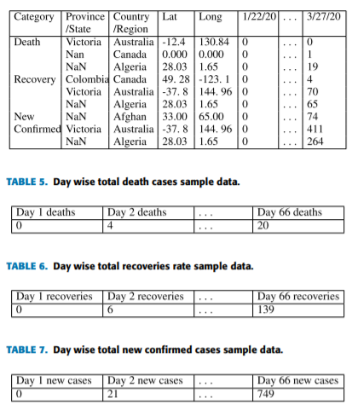
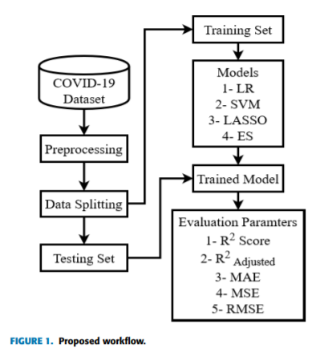
III. METHODOLOGY
The Proposed Workflow will be according to the flowchart given below:

Slide 12
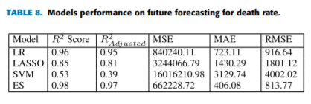
IV. RESULTS AND DISCUSSION DEATH RATE FUTURE FORECASTING
The study performs predictions on death rate and according to results ES performs better among all the models, LR and LASSO perform equally well and achieve almost the same R 2 score. In comparison, SVM performs worst in this situation

Slide 13
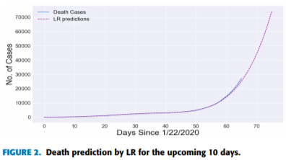
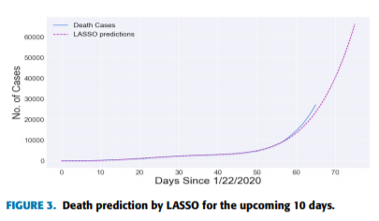
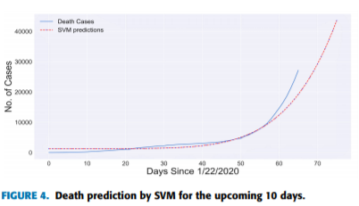
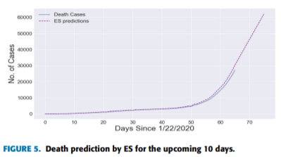
DEATHS FUTURE FORECASTING - 2
These are the graphs obtained by the results:

Slide 14
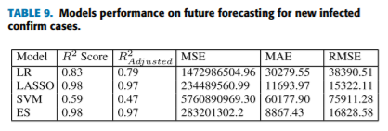
NEW INFECTED CONFIRM CASES’ FUTURE FORECASTING
The new confirmed cases of COVID-19 increase day by day shows the forecasting results of the models used in this study. ES and LASSO lead the table in terms of performace, LR also performed good, while SVM performs very poorly in terms of all the evaluation metrics.

Slide 15
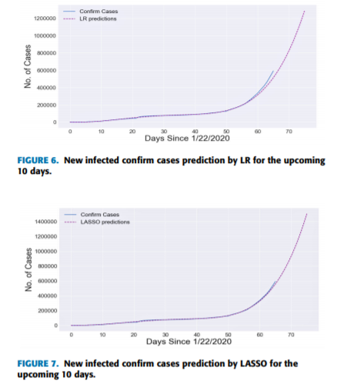
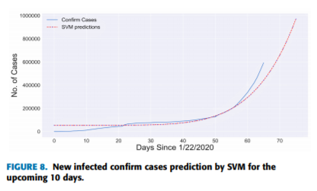
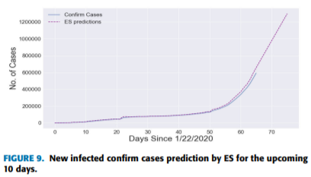
NEW INFECTED CONFIRM CASES’ FUTURE FORECASTING
These are the graphs obtained by the results:

Slide 16
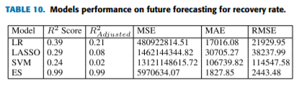
RECOVERY RATE FUTURE FORECASTING
In recovery rate future forecasting the ES again performs better among all the other models. All other models perform poorly, the order of performance from best to worst is ES is best followed by LR, LASSO and SVM due to the nature of available time-series data.

Slide 17
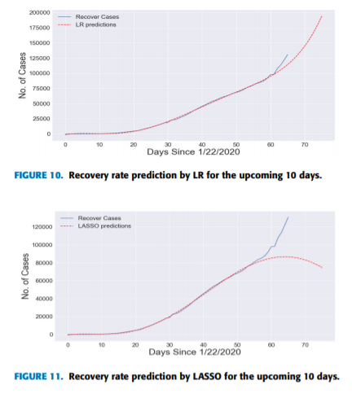
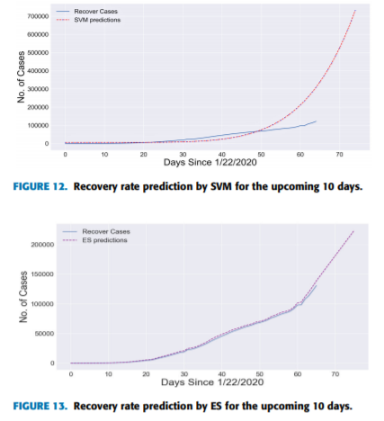
RECOVERY RATE FUTURE FORECASTING - 2
These are the graphs obtained by the results:

Slide 18
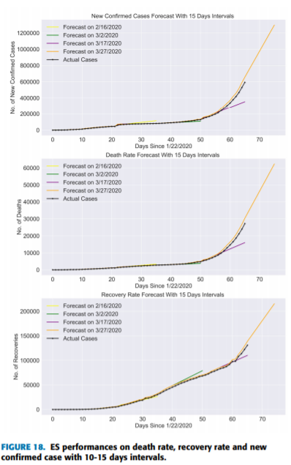
COMPARISON

Slide 19
IMPLEMENTATION STRATEGY
The Strategy will cover the implementation of one of the 4 regression model explained in the paper.
The dataset is available in the Github repository and from there I will start the implementation
After the implementation of one model, the results will be compared to the results of other models in the paper.

Slide 20
CONCLUSION
The precariousness of the COVID-19 pandemic can ignite a massive global crisis. Some researchers and government agencies throughout the world have apprehensions that the pandemic can affect a large proportion of the world population.
The results of the study prove that ES performs best in the current forecasting domain given the nature and size of the dataset. LR and LASSO also perform well for forecasting to some extent to predict death rate and confirm cases. According to the results of these two models, the death rates will increase in upcoming days, and recoveries rate will be slowed down. SVM produces poor results in all scenarios because of the ups and downs in the dataset values.

Slide 21
REFERENCES
IEEE PAPER - COVID-19 Future Forecasting Using Supervised Machine Learning Models by FURQAN RUSTAM , AIJAZ AHMAD RESHI , (Member, IEEE), ARIF MEHMOOD , SALEEM ULLAH , BYUNG-WON ON4 , WAQAR ASLAM, (Member, IEEE), AND GYU SANG CHOI.
https://journals.plos.org/plosone/article?id=10.1371/journal.pone.0231236.

